Slide 1
Reading Meeting Quiz:
ICRU and Isodose

Slide 2
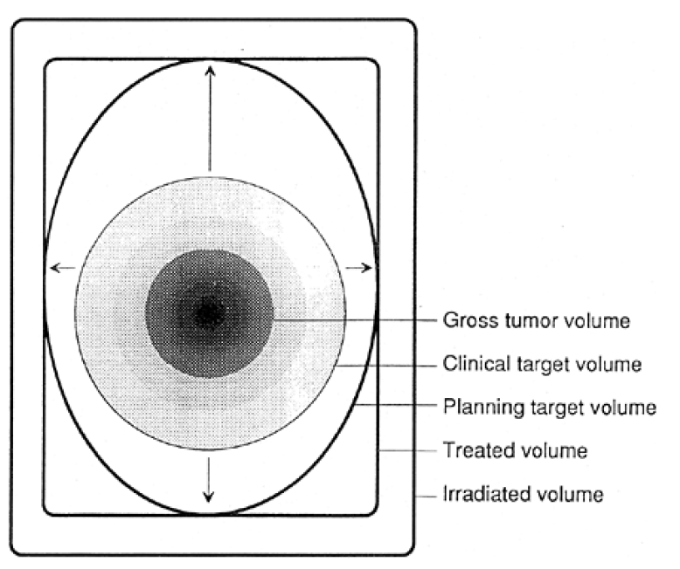
Q1
Where would you find this diagram and what is it’s significance?
What are the regions?
What is a typical margin between region 2 and 3? What factors affect this margin?
What changes in the supplement of this document?
1
2
3
4
5
Notes:
ICRU 50
5mm
Supplement 62: add the internal margin

Slide 3
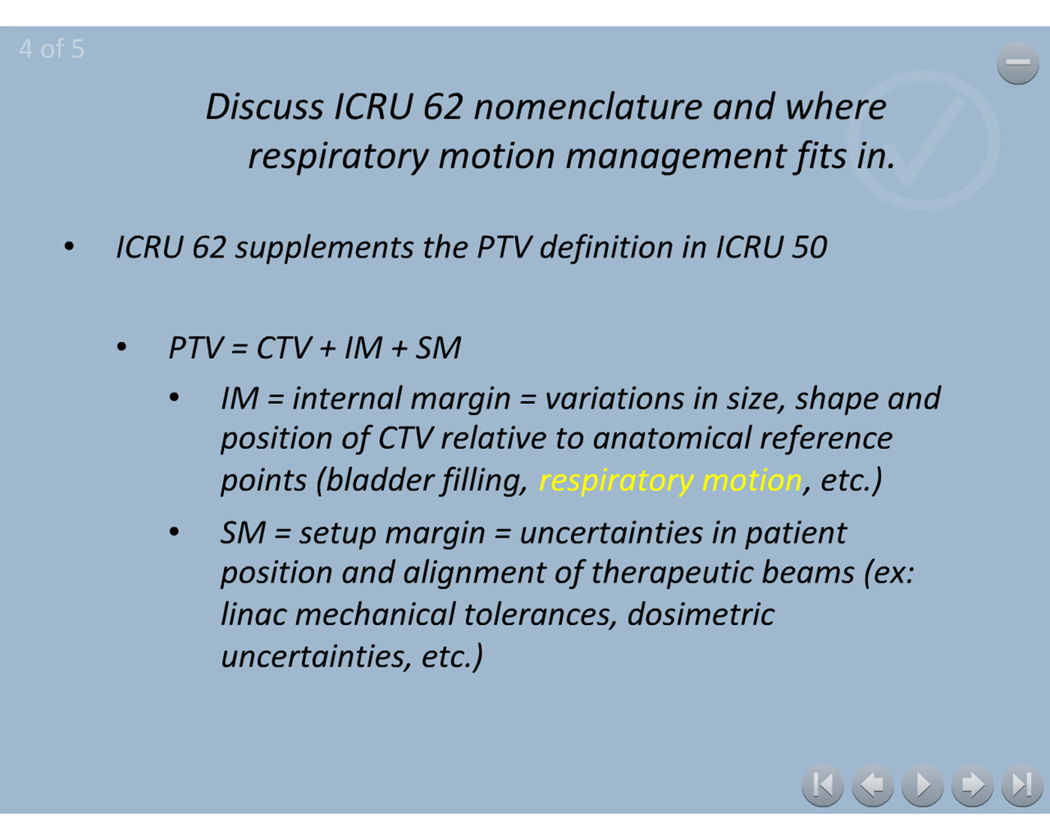

Slide 4
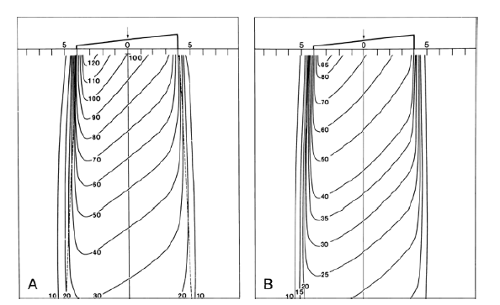
Q2
Define Wedge Angle
What is the wedge angle in the figure?
Notes:
figure 11.6 khan
Wedge angle: angle through which an isodose curve is tilted at the central ray of a beam at a specified depth
normalized to dmax, B) normalized to dmax without the wedge, 45 degree wedge angle

Slide 5
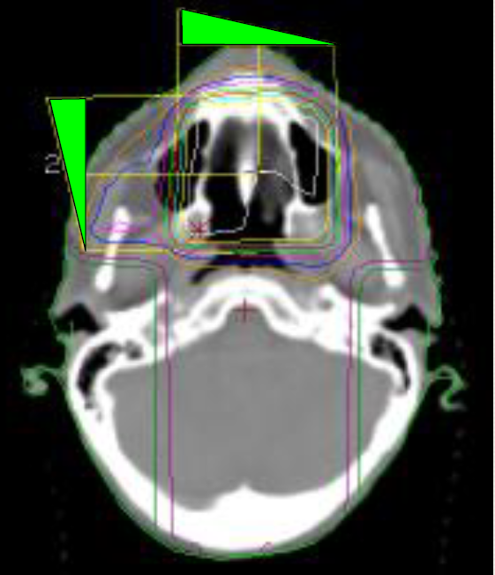
Q3
Define Hinge Angle. What hinge angle is used in this plan?
What treatment sites typically use wedges? Why?
Explain the wedge system used at your institution
Notes:
hinge angle: angle between the central axes of the two beams
breast, eye, c-spine, 3 field pelvis
EDW

Slide 6
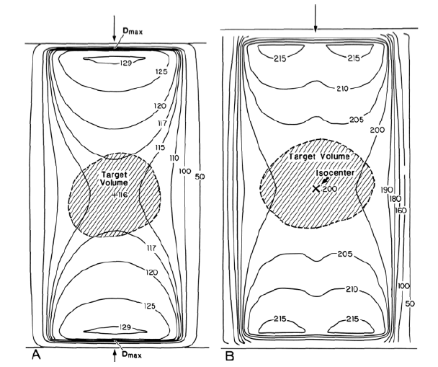
Q4
What is the difference between A and B?
What treatment sites would you use this beam arrangement?
Notes:
Figure 11.10 khan green version
SSD technique: 100 at Dmax B)isocentric plan, each beam weighted 100 at isocenter

